Slide 1
Anima Custom Page
2023-09-11
Niao Jina

Slide 2
Project Goal
Combining modern dance and drawing using Meta’s AI open source and AI motion capture data

Slide 3
Overview
1. Project description
The etymology of animation – comes from the Greek word ‘Animal’ or the Latin word ‘Anima’ – means soul, spirit, and life. "animate" is a word made from [anim vitality, breath] + [ate verb, adjective], and 'dance' comes from the Sanskrit word 'Tanha', which means 'desire for life'. The human body is 'Built to Move', In other words, by combining drawing and dancing, which are fundamental human needs, with the 'Keep Drawing' project that brought animation to life, focusing on the fact that it is optimized for movement, and producing content that can be distributed/distributed through AI technology and offline and online.
2. Project basic idea
Create unpredictable new forms of visuals and content through a combination of artist guide + citizen participation + AI technology
It is a combination of digital and analog, animation and modern dance to create a convergence creation, and the work can be developed through the diverse creativity of children, the elderly and citizens.
Summary of Anima custom page features
In particular, we secured unprecedented creativity by combining unique movements unique to modern dance rather than simply K-pop or general motions or choreography.
A studio shelter where dots come together to form a line, lines come together to create a picture, and pictures come together to create an animation, the spirit of the <Keep Drawing> project and AI technology have been combined to create <Keep Dancing> content.

Slide 4
Key references
Creation of a website using open source Animated Drawings distributed by meta https://github.com/facebookresearch/AnimatedDrawings
Creating a website similar to the AnimatedDrawing homepage structure https://sketch.metademolab.com/canvas

Slide 5
Requirements - 1
Participants upload their own drawings

Slide 6
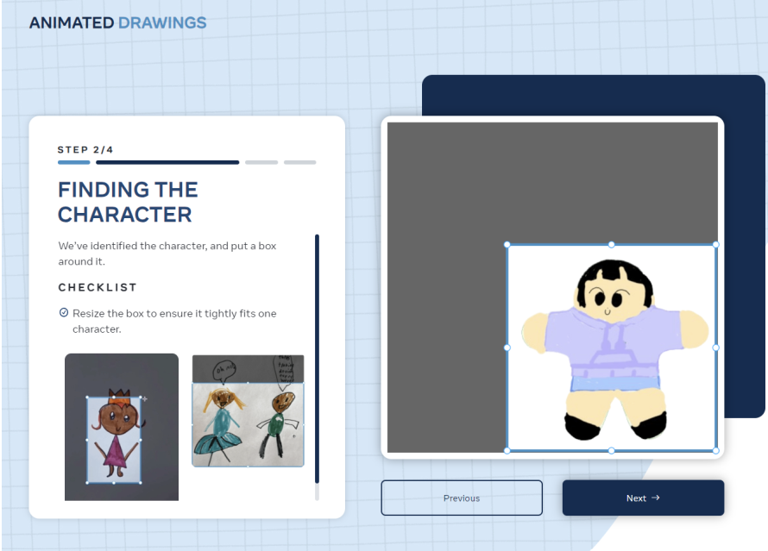
Requirements - 2
Setting the uploaded picture area

Slide 7
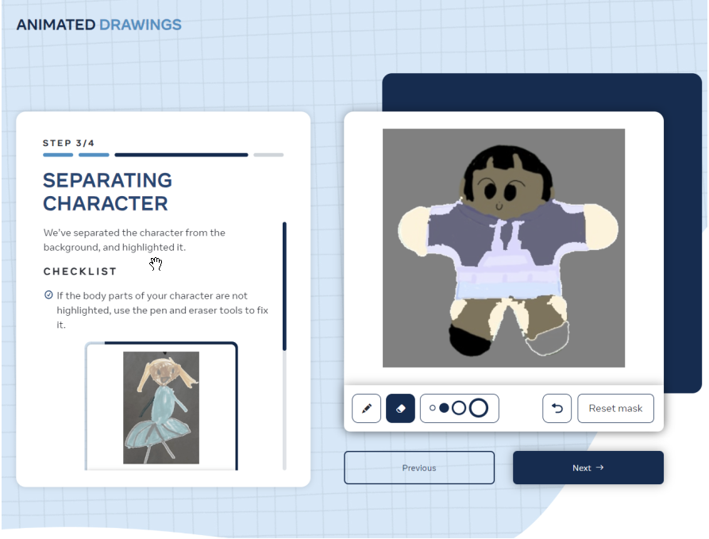
Requirements - 3
Color or erase drawing areas

Slide 8
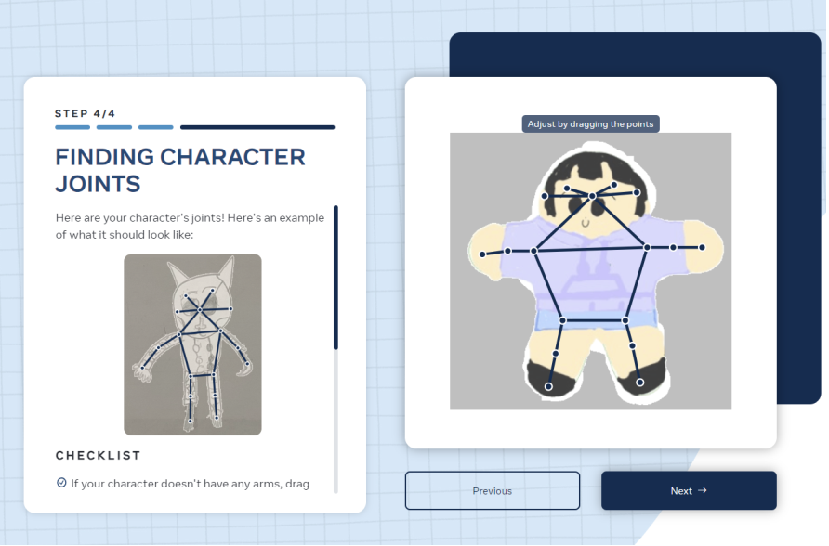
Requirements - 4
Character joint settings

Slide 9
Requirements - 5
Extract your own motion (record video or upload video)
Convert motion to bvh using artificial intelligence mocap API or pose recognition mocap

Slide 10
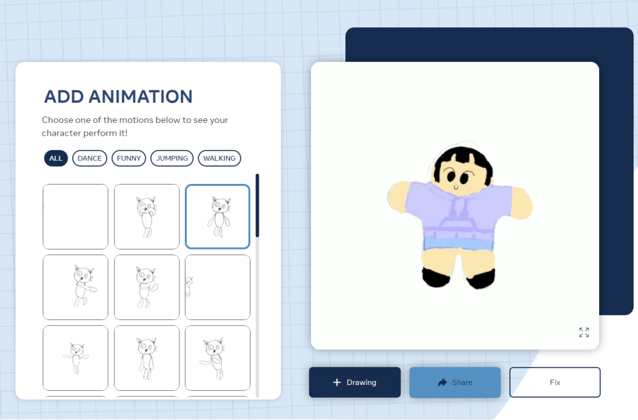
Requirements - 6
Applying motion to the character you drew

Slide 11
Requirements - 7
Applying motion to the character you drew

Slide 12
Requirements - 8
Save as MP4 and GIF and share with others as a link

Slide 13
Thank You

